Slide 1
C-STORE OFFICE
ADVANCED ACCOUNTING – Recording Lottery Commissions

Slide 2
Agenda
How do I account for the recording of lottery commissions in C-Store?

Slide 3
HOW DO I ACCOUNT FOR THE RECORDING OF LOTTERY COMMISSIONS IN C-STORE?
Step 1: Go to your Account Register > Transactions > Account Register > (Put in your company, class, and the bank account to deposit the commission.
Step 2: Find the next open space in the journal entries for your bank account selected.

Slide 4
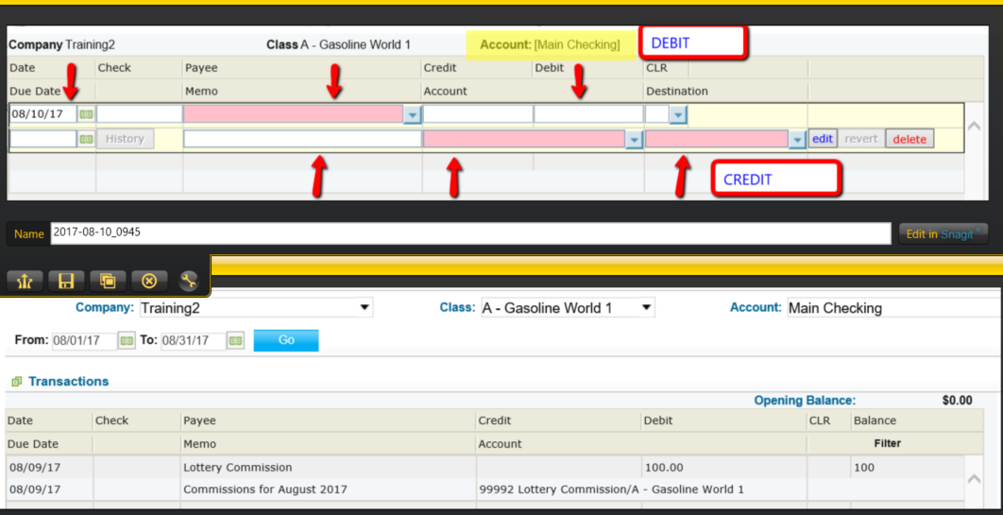
HOW DO I ACCOUNT FOR THE RECORDING OF LOTTERY COMMISSIONS IN C-STORE?
Step 3: Record the journal entry (Bank Account).
* Accounts Register > Pick Company, Class > Account 1 will be a bank account
* When opening a journal entry space in the selected account, this will be the debited account
* After the entry information is filled in, you must press EDIT/ENTER and SAVE to see it appears in the account register
NEW
DONE

Slide 5
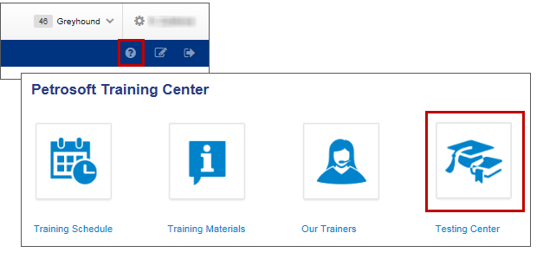
TRAINING CENTER
For additional testing on what you have learned, please refer to our new “Testing Center”.
To access this new feature, click the help icon, and then select Testing Center.

Slide 6
THANK YOU FOR YOUR TIME!
Get in Touch
www.cstoreoffice.com
Petrosoft LLC
290 Bilmar Drive
Pittsburgh, PA 15205
1.412.306.0640

